Slide 1
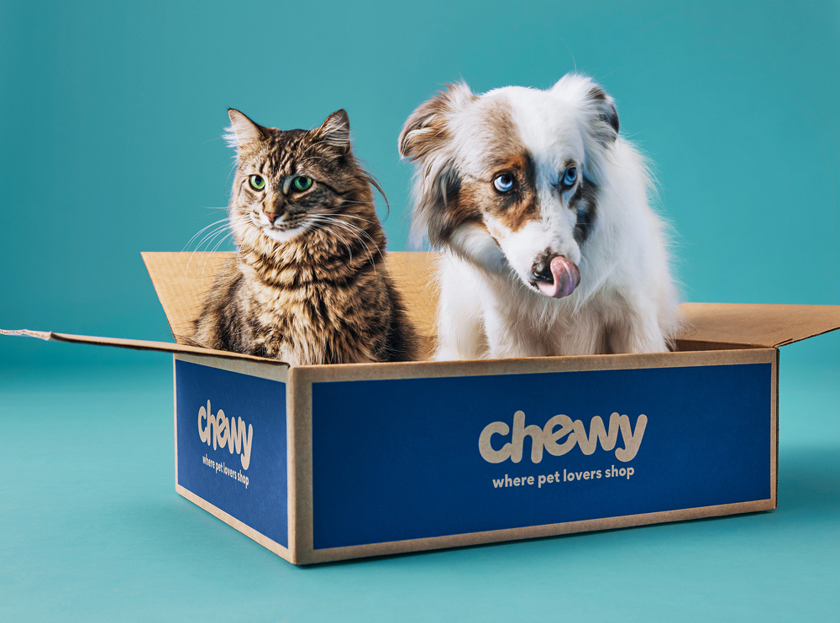


MARCH 9, 2025
Sales Kit
More Than Ads
Genuine connections With Pet Parents
Biamah Ampofo-Tenkorang

Slide 2
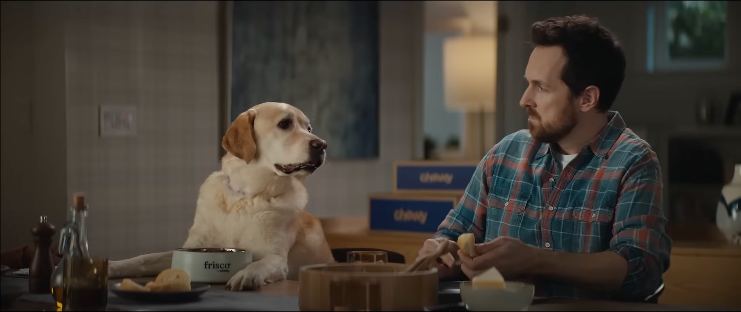

At Chewy, pets are family.
With Chewy Ads, your brand can engage passionate pet parents through data-driven advertising solutions that inspire, convert, and grow

Slide 3




First-party data from 20M+
Why Us?
active customers, enabling precise audience targeting
We are more than an online pet retailer;
a trusted partner to millions of passionate pet parents. With a loyal customer base and a personalized shopping experience, Chewy Ads empowers brands to engage pet lovers at the perfect moment, driving higher conversions and repeat sales.
80% sales from subscriptions
With 80% of sales driven by Autoship subscriptions, advertisers
can reach a loyal customer base, ensuring repeat purchases
1 in 3 ad clicks
results in a purchase, and 45% of ad attributed purchases lead to
recurring orders
(Source: Digital Commerce 360, 2025)

Slide 4



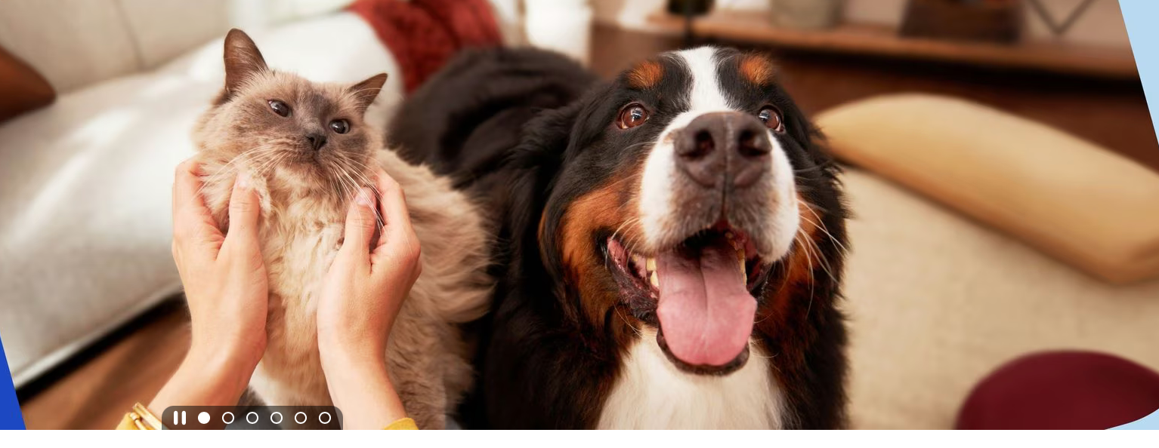



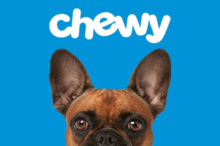
Meet our Pet-Obsessed Community
Our audience consists of dedicated pet owners who prioritize their pets’ well-being and are highly engaged with Chewy. With a strong focus on middle to upper-middle class individuals, particularly females, our services allow you to tap into this highly valuable demographic, ensuring targeted, impactful advertising opportunities
AGE RANGE: PRIMARILY 25-54 YEARS OLD
predominantly female: 67.79%
INCOME LEVEL: MIDDLE TO UPPER-MIDDLE CLASS
willing to invest in premium products for pets
CUSTOMER SEGMENTS:
Young professionals, families, pet enthusiasts & social media influencers
PURCHASING BEHAVIOUR:
Average sales per active customer in third quarter (2023) hit $567
(Source: GlobalPETS, 2024)

Slide 5
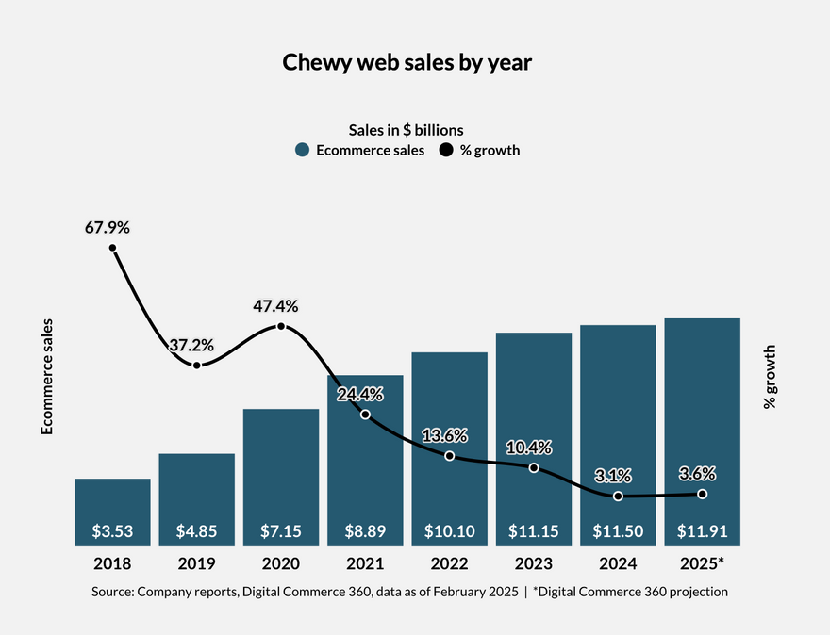

Revolutionalizing Pet Retail
Online retailer with wide range of products: food, supplies, medications,
coupled with execeptional customer service
Net Sales
$11.15B
20M+
Gross Profit
$3.16B
Customers
Net Income
$39.6M
(Source: Chewy, Inc. (2024). Annual report (Form 10-K)

Slide 6
Our Solutions
Home
About
Contact
Driving Impact With Chewy Ads
Display Advertising
Interactive Ads
Loyalty Ads
Maximize exposure with display ads strategically placed across Chewy’s site. Engage pet parents with static or dynamic banners on high-traffic pages, driving conversions at key decision-making moments..
Make shopping interactive with shoppable videos and AR previews that let pet parents explore and buy with ease. Engage customers at every step with dynamic, educational ads that enhance the shopping experience and drive conversions.
Boost retention with exclusive ads for Chewy Plus members and Autoship subscribers. Target high-value customers with personalized offers, early access deals, and premium product promotions—driving repeat purchases and long-term loyalty.

Slide 7
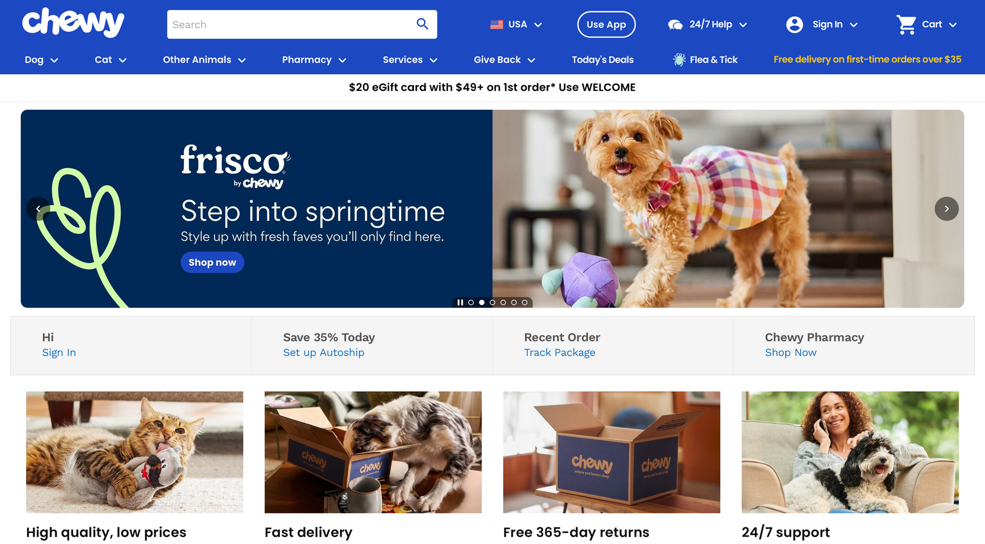
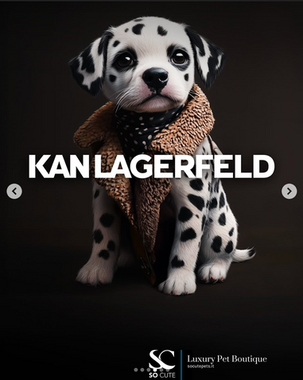



Mock Up #1
SO CUTE LUXURY PET BOUTIQUE
10% OFF WITH CODE:
PAWSH&BOUJEE
Digital Banner

Slide 8

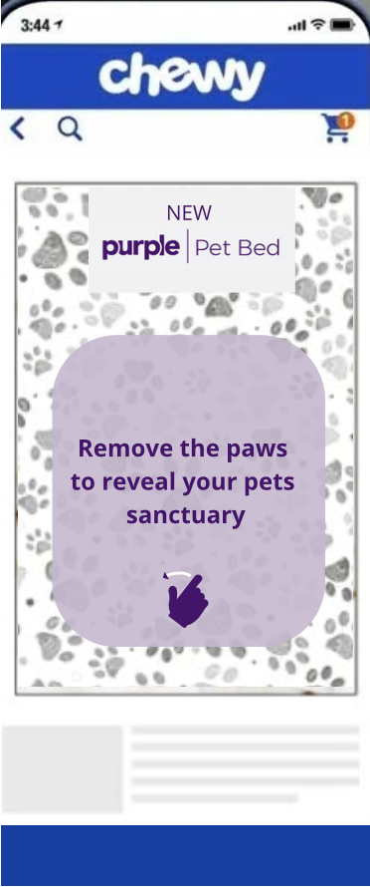
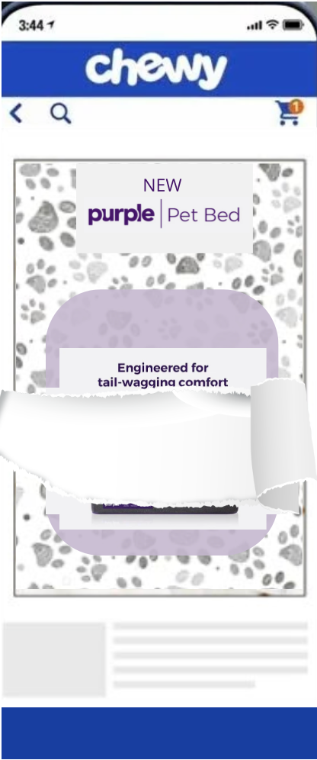
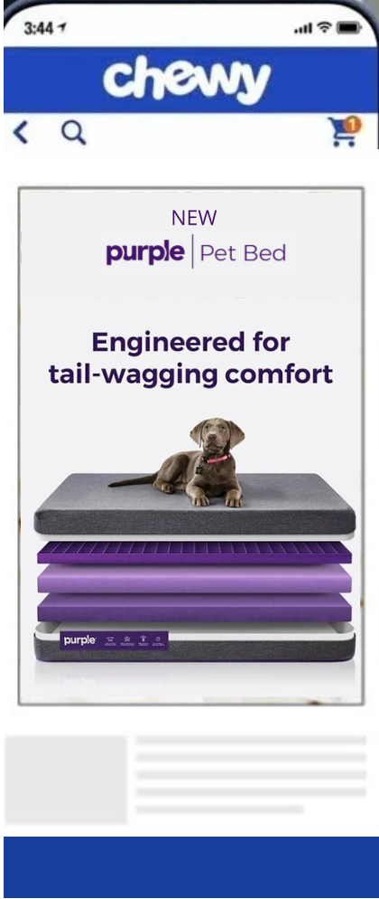
Mock Up #2
Interactive Ads
Concept: “Swipe to Reveal Purple Pet Bed”. An interactive mobile ad invites users to swipe and uncover the new product, showcasing its comfort and innovative design in a fun and engaging way.

Slide 9
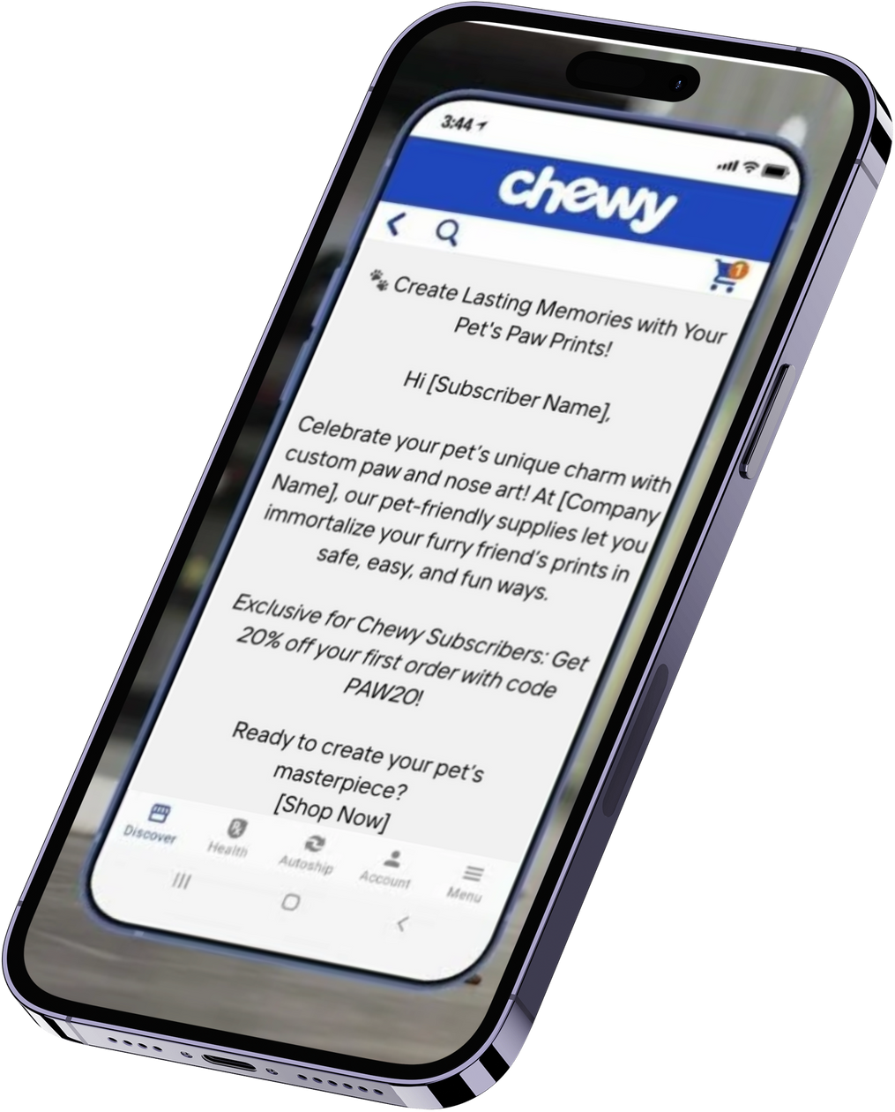
Mock Up #3
Loyalty Ads: Targeted, Personalized & Impactful
Chewy enables businesses to reach the right customers with personalized loyalty ads, delivered via app, web, or email. Using data-driven insights, we target subscribers based on their preferences, purchase history, and browsing behavior. This ensures every ad feels relevant, increasing engagement and conversions.

Slide 10
Thank you

Slide 11
Resource Page
SimilarWeb. (2025). Chewy.com Website Traffic & Demographics. Retrieved from [SimilarWeb](https://www.similarweb.com/website/chewy.com/#geography)
Canvas Business Model. (2025). Chewy Target Market Analysis. Retrieved from [Canvas Business Model](https://canvasbusinessmodel.com/blogs/target-market/chewy-target-market)
Global Pet Industry. (2025). Chewy Reports Sales Growth as Customer Numbers Remain Stable. Retrieved from [Global Pet Industry](https://globalpetindustry.com/news/chewy-reports-sales-growth-as-customer-numbers-remain-stable/)
Chewy, Inc. (2024). Annual Report (Form 10-K). Retrieved from [EDGAR Online](https://content.edgaronline.com/ExternalLink/EDGAR/0001766502-24-000014.html?hash=4c96d4f74d2be80b9aac1ef058b00233162fc327f396f496290441ac2cb87c69&dest=chwy-20240128_htm#chwy-20240128_htm)

